Slide 1
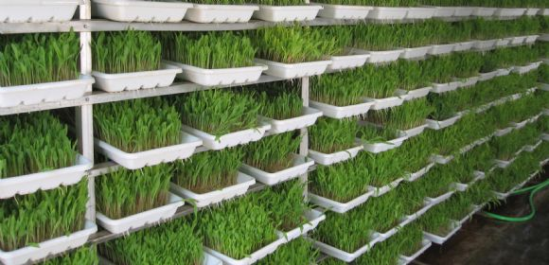

MINI PROJECT PHASE- 2 PRESENTATION
IOT BASED FARMING SOLUTION
Dept. of Electronics and Instrumentation Engineering, RVCE
By-
Siddesha GV (1RV13IT018)
Karthik HG (1RV13IT022)
Shanthilal K (1RV13IT046)
Vasishta HD (1RV13IT058)
Under the guidance of-
Mr. Sandesh R S
Dept. of Electronics and Instrumentation

Slide 2
PROBLEM STATEMENT
There is a need for an efficient and cost effective method of system for the control, monitoring and analysis of the farming techniques with some degree of automation.
OBJECTIVES
To create an on-farm network that provide remote and real time monitoring and control of important farming functions with improved efficiency.
To data log the information on to cloud/custom websites from the field in order to use them for further analysis.

Slide 3
BLOCK DIAGRAM
Power Supply
Processing and Computation -
Atmega328
SENSOR-
DHT11
Relay
Motor
230V AC- MAINS
Ethernet cable
Data logging to cloud servers and custom websites

Slide 4
EXPERIMENTAL RESULTS

Slide 5
WORK DONE TILL NOW
The basic working of the sprinkler system based irrigation system is carried out.
The timing and control of the above mentioned system based on sensor input and driving the motor system is carried out using the AtMega328 controller is done.
The control of motor through a custom made webpage is achieved.
The logging of the sensor data is separately achieved.

Slide 6
PLAN OF WORK
A complete design of the system as a product.
Incorporating changes in the design of the circuits in order to make the system more flexible to the user(Keypad and LCD displays).
Hourly data log of sensor input to the cloud server through ESP8266.
Designing of the web-pages for complete control of the field unit.
To create a database of the sensor data(weather report) and to display the same in the web pages.
Use the same for next level of predictions regarding crop rotation and other farming techniques.

Slide 7
REFERENCES
Experimental investigation of remote control via Android smart phone of arduino-based automated irrigation system using moisture sensor, 2016 3rd International Conference on Electrical Energy Systems
Novel, Low cost Remotely operated smart Irrigation system, 2015 International Conference on Industrial Instrumentation and Control
Smart irrigation system using raspberry pi, Volume: 03 Issue: 05, May-2016, International Research Journal of Engineering and Technology
Automated Irrigation System In Agriculture Using Wireless Sensor Technology, IJAREEIE, Vol. 3, Issue 12, December 2014
Smart drip irrigation system using raspberry pi and arduino, 15-16 may 2015

